Slide 1

HW1b Release September 7, 2018 Due date September 17, 2018 11:59pm

Slide 2
CSCI 561 Foundations of Artificial Intelligence Lecture 7: Adversarial Search (Games) (Chapter 5)
FALL 2018
Instructor: Prof. Sheila Tejada
cs561-l@mymaillists.usc.edu

Slide 3
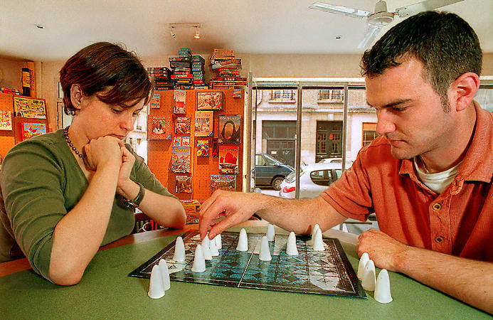
Games
Games are a form of multiagent environment
It matters what other agents do and how this affects success
Other agents can add nondeterminism: don’t know what they’ll do
Cooperative vs. competitive vs. mixed multiagent environments
Cooperative: identical goals
Competitive: opposing goals
Mixed: cooperative and competitive
Competitive multiagent environments give rise to adversarial search, a.k.a. games

Slide 4
Why Study Games?
Fun
Easy to define but difficult to play well
Chess: b = 35, m=100 ⇒ nodes = 35 ¹⁰⁰ if each node takes about 1 ns to explore then each move will take about 10 ⁵⁰ millennia to calculate.
Chance to interact with people
A significant component of the history/success of AI
Machines have had considerable success here
Focus here is mostly on traditional board games
Video games require other things, such as virtual humans
One aspect of multiagent systems

Slide 5
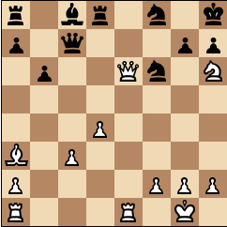
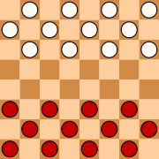
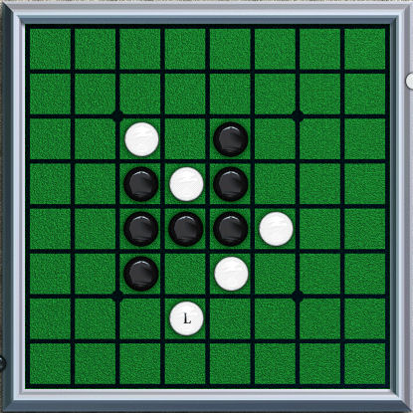
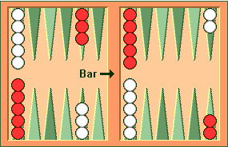
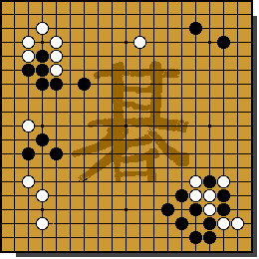
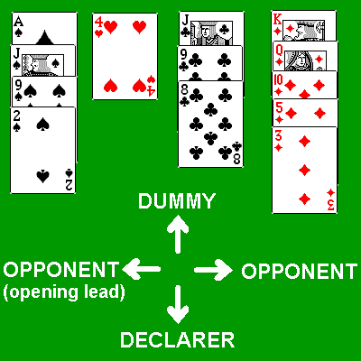
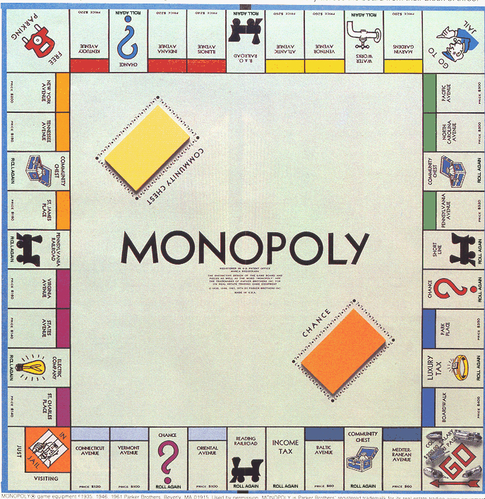
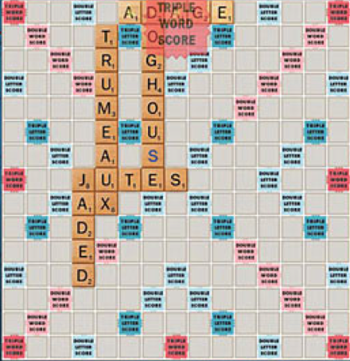
Games and Search
What we have seen so far is single-agent search
Solution is usually a single path to a goal state
Focus is frequently on finding optimal solutions
f(n) is an estimate of cost from start to goal through given node
Examples: path planning, scheduling, puzzles
Games are two-or-more person adversarial search
Solution usually a branching (tree) contingency plan: need to consider all your opponent might do
Examples: chess, checkers/draughts, othello/reversi, backgammon, go, bridge, poker, monopoly, scrabble

Slide 6
Searching for the next move
Resource (e.g., time, memory) limit: optimal solution not feasible/possible, thus must approximate
Pruning: makes the search more efficient by discarding portions of the search tree that cannot improve quality result.
Evaluation functions: heuristics to evaluate utility of a state without exhaustive search.

Slide 7
Types of Games
Deterministic
Stochastic
chess, checkers, go, othello, … | backgammon, monopoly, …
Battleship, above with time/space limits | Bridge, poker, scrabble, …
Perfect
Information
Imperfect
Information
Notes:
Differentiate whether game itself is stochastic versus uncertainty due to other players.
Differentiate whether all information is available to players versus some hidden.

Slide 8
Generate Game Tree

Slide 9
Generate Game Tree
MAX
x
 | x
x
 |  | x

Slide 10
Generate Game Tree
MAX
 | x
MIN
 | x | o
o | x
 | x
 | o
 | x
o

Slide 11
Generate Game Tree
MAX
 | x
1 ply
MIN
1 move
 | x | o
o | x
 | x
 | o
 | x
o

Slide 12
A subtree
x
o
x
o
x
o
win
MAX
lose
x
o
x
x
o
x
x
o
x
draw
x
o
x
o
x
o
x
MIN
o
x
o
x
o
x
o
x
x
o
x
x
o
x
x
o
x
x
o
x
x
o
x
x
o
x
x
o
x
o
o
x
o
x
o
o
x
o
x
o
o
o
o
x
o
x
o
o
x
o
o
x
o
MAX
x
o
x
x
o
x
x
o
x
x
o
x
x
o
x
o
o
x
o
o
x
x
o
x
o
x
o
x
x
o
x
x
o
o
x
o

Slide 13
What is a good move?
x
o
x
o
x
o
win
MAX
lose
x
o
x
x
o
x
x
o
x
draw
x
o
x
o
x
o
x
MIN
o
x
o
x
o
x
o
x
x
o
x
x
o
x
x
o
x
x
o
x
x
o
x
x
o
x
x
o
x
o
o
x
o
x
o
o
x
o
x
o
o
o
o
x
o
x
o
o
x
o
o
x
o
MAX
x
o
x
x
o
x
x
o
x
x
o
x
x
o
x
o
o
x
o
o
x
x
o
x
o
x
o
x
x
o
x
x
o
o
x
o

Slide 14
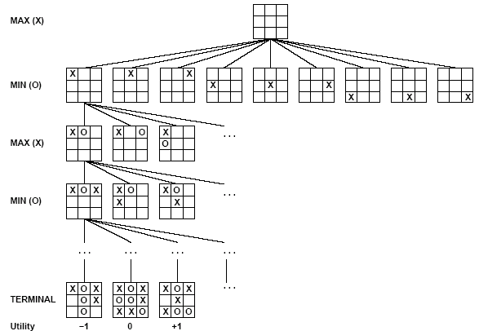
Partial Game Tree for Tic-Tac-Toe
Max tries to maximize utility (from X’s perspective) of move
Min tries to minimize utility (from X’s perspective) of move

Slide 15
Optimal Strategies
Find a contingent strategy for MAX assuming infallible MIN
Assumption: Both players play optimally
Given a game tree, the optimal strategy can be determined by using the minimax value of each node:
MINIMAX-VALUE(n)=
UTILITY(n) If n is a terminal
max_{s ∈ successors(n)} MINIMAX-VALUE(s) If n is a max node
min_{s ∈ successors(n)} MINIMAX-VALUE(s) If n is a min node
Implicitly defines a recursive search algorithm (Minimax)

Slide 16
Minimax
3
12
8
2
4
6
14
5
2
Minimize opponent’s chance
Maximize your chance

Slide 17
Minimax
3
2
2
MIN
3
12
8
2
4
6
14
5
2
Minimize opponent’s chance
Maximize your chance

Slide 18
Minimax
3
MAX
3
2
2
MIN
3
12
8
2
4
6
14
5
2
Minimize opponent’s chance
Maximize your chance

Slide 19
Minimax
3
MAX
3
2
2
MIN
3
12
8
2
4
6
14
5
2
Minimize opponent’s chance
Maximize your chance

Slide 20
Minimax Algorithm

Slide 21
Evaluation of Minimax
Completeness
Yes (exhaustive)
Optimality
Yes (exhaustive)
Time complexity
O(b^{m})
Space complexity
O(bm) or O(m)
Time Complexity is the Big Problem

Slide 22
More on the α-β algorithm
MAX
…
MIN
5 10 6 2 8 7

Slide 23
More on the α-β algorithm
MAX
…
MIN
5 10 6 2 8 7

Slide 24
More on the α-β algorithm
MAX
…
MIN
5 10 6 2 8 7

Slide 25
More on the α-β algorithm
MAX
5
…
MIN
5 10 6 2 8 7

Slide 26
More on the α-β algorithm
Remember: MAX can get at least 5
MAX
5
…
MIN
5 10 6 2 8 7

Slide 27
More on the α-β algorithm
Remember: MAX can get at least 5
MAX
5
…
MIN
5 10 6 2 8 7

Slide 28
More on the α-β algorithm
Remember: MAX can get at least 5
MAX
5
…
MIN
5 10 6 2 8 7

Slide 29
More on the α-β algorithm
Remember: MAX can get at least 5
MAX
5
…
MIN
5 10 6 2 8 7

Slide 30
More on the α-β algorithm
Remember: MAX can get at least 5
MAX
5
…
MIN
5 10 6 2 8 7
MIN will only give MAX 2 if this subtree chosen

Slide 31
More on the α-β algorithm
Remember: MAX can get at least 5
MAX
5
…
MIN
5 10 6 2 8 7
MIN will only give MAX 2 if this subtree chosen

Slide 32
More on the α-β algorithm
Remember: MAX can get at least 5
MAX
5
…
MIN
5 10 6 2 8 7
MIN will only give MAX 2 if this subtree chosen
Don’t need to consider these nodes

Slide 33
Minimax Algorithm

Slide 34
More on the α-β algorithm: start from Minimax

Slide 35
α = -∞
β = +∞
In Max-Value:
Max-Value loops
over these nodes
MAX
…
MIN
α = -∞
β = +∞
MAX
5 10 6 2 8 7

Slide 36
More on the α-β algorithm
α = -∞
β = +∞
MAX
In Min-Value:
MIN
…
α = -∞
β = +∞
Min-Value loops
over these nodes
MAX
5 10 6 2 8 7

Slide 37
More on the α-β algorithm
α = -∞
β = +∞
MAX
In Min-Value:
MIN
…
Min-Value loops
over these nodes
MAX
5 10 6 2 8 7

Slide 38
More on the α-β algorithm
α = -∞
β = +∞
MAX
In Min-Value:
MIN
…
α = -∞
β = 5
Min-Value loops
over these nodes
MAX
5 10 6 2 8 7

Slide 39
More on the α-β algorithm
α = -∞
β = +∞
MAX
In Min-Value:
MIN
…
α = -∞
β = 5
Min-Value loops
over these nodes
MAX
5 10 6 2 8 7

Slide 40
More on the α-β algorithm
In Max-Value:
MAX
α = 5
β = +∞
MIN
…
MAX
5 10 6 2 8 7

Slide 41
More on the α-β algorithm
In Max-Value:
MAX
Max-Value loops
over these nodes
α = 5
β = +∞
MIN
…
MAX
5 10 6 2 8 7

Slide 42
More on the α-β algorithm
MAX
α = 5
β = +∞
MIN
…
Min-Value loops
over these nodes
MAX
5 10 6 2 8 7

Slide 43
More on the α-β algorithm
In Min-Value:
MAX
α = 5
β = +∞
MIN
…
Min-Value loops
over these nodes
MAX
5 10 6 2 8 7

Slide 44
More on the α-β algorithm
In Min-Value:
MAX
α = 5
β = +∞
MIN
…
Min-Value loops
over these nodes
MAX
5 10 6 2 8 7

Slide 45
More on the α-β algorithm
In Min-Value:
MAX
α = 5
β = +∞
MIN
…
Min-Value loops
over these nodes
MAX
5 10 6 2 8 7

Slide 46
More on the α-β algorithm
In Min-Value:
MAX
= 5
β = +∞
v = 2
MIN
…
Min-Value loops
over these nodes
MAX
5 10 6 2 8 7

Slide 47
More on the α-β algorithm
In Min-Value:
MAX
= 5
β = +∞
v = 2
MIN
…
Min-Value loops
over these nodes
MAX
5 10 6 2 8 7
v <= α
End loop
Return 2

Slide 48
More on the α-β algorithm
MAX
Max-Value loops
over these nodes
MIN
…
MAX
5 10 6 2 8 7
β <= α
End loop
Return 5

Slide 49
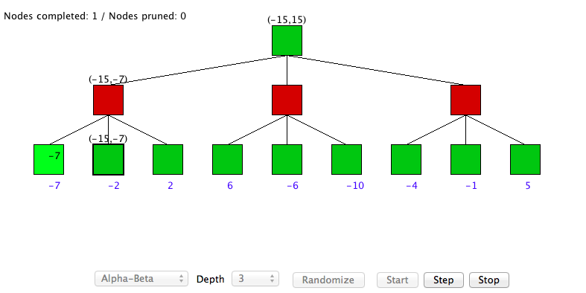
α-β algorithm DEMO
http://www.ocf.berkeley.edu/~yosenl/extras/alphabeta/alphabeta.html

Slide 50
Comments on Alpha-Beta
Pruning does not affect final results
Entire subtrees can be pruned
Good move ordering improves effectiveness of pruning
Want to look at best child first
With “perfect ordering,” time complexity is O(b^{m/2})
Search is effectively only half as deep [b^{(m/2)}]
Can look twice as far as minimax in the same amount of time
Various other improvements are also possible
However, still not good enough to reach end of any significant games in real time!

Slide 51
Making Game Search Tractable Shifting to Heuristic/Imperfect Information
Minimax and alpha-beta pruning require too much search to reach leaf nodes of game
Usually impractical within reasonable time bounds
Although recent approaches are doing huge searches offline and storing tables for use during games
Alternative
Cut off search earlier (replace TERMINAL-TEST by CUTOFF-TEST)
Apply heuristic evaluation function EVAL to replace the utility function of alpha-beta
Deal with other consequences of cutting off search

Slide 52
Cutting Off Search
Change:
if TERMINAL-TEST(state) then return UTILITY(state)
into
if CUTOFF-TEST(state,depth) then return EVAL(state)
Introduces a fixed-depth limit depth
Depth usually set by time available
When cuttoff occurs, the evaluation is performed

Slide 53
Heuristic EVAL
EVAL idea: produce an estimate of the expected value of the game at a given position
Performance depends critically on quality of EVAL
Desiderata:
EVAL should order terminal nodes in same way as UTILITY
Computing EVAL should not take too long
Whatever time is spent in EVAL isn’t spent searching other nodes
For non-terminal states, EVAL should be strongly correlated with the actual chance of winning

Slide 54
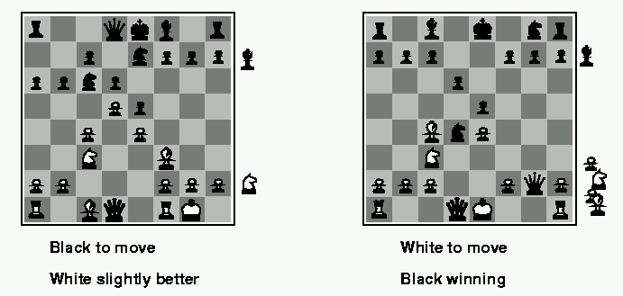
Evaluation functions
Weighted linear evaluation function: to combine n heuristics f = w₁f₁ ₊ w₂f_{2 + … +} w_{n}f_{n}
E.g, w’s could be the values of pieces (1 for prawn, 3 for bishop etc.) f’s could be the number of type of pieces on the board

Slide 55
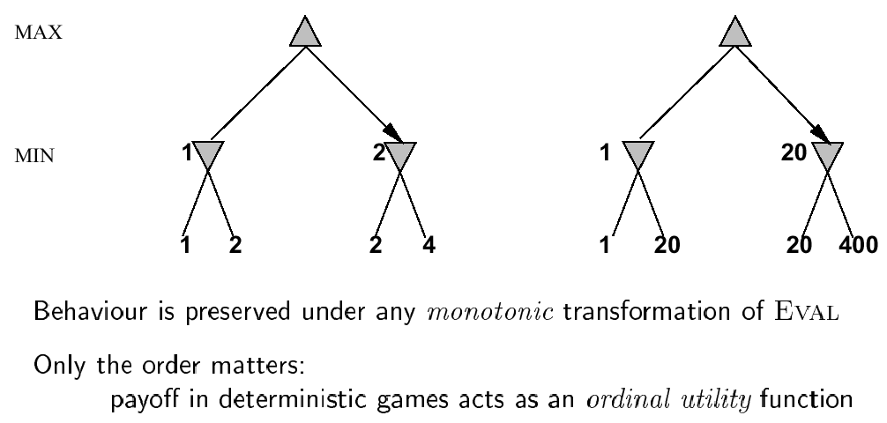
Note: exact values do not matter

Slide 56
General EVAL Considerations
Factors like material, mobility (options), stability (security) matter in many games
Cost of performing EVAL is critical
Trade off with searching more nodes
Capture as much as possible into tables ahead of time
Learning of parameters and patterns can be crucial for high performance

Slide 57
Key Problem with Cutoff/EVAL
Can’t see what happens beyond cutoff
Can overvalue a position where disaster will happen immediately after last ply actually searched
E.g., in chess, where queen is taken on next move
Can add useless or counterproductive delaying moves to push disasters past cutoff
Called the horizon effect
Searching deeper helps avoid both problems
There are also approaches for going deeper selectively
E.g., Quiescence search and singular extensions
Notes:
Quiescence search: Search active positions (evaluation more labile) than quiet positions
Singular extensions: Extend search one ply for moves that are relevant and look much better than alternatives

Slide 58
Beyond α-β and EVAL
Techniques for reducing search further
Better algorithms or better orderings for α-β
Time management
Allocation across moves (based on criticality/need)
Anytime algorithm – produces ok solution quickly then improves
Iterative deepening helps with both search and time
Use results from previous iterations to order later searches
When time elapses, use result from last completed iteration
Opening books and endgame tables
Store information about what to do in key positions
Either precomputed or gathered from experts
Deep Blue went in for this big time
In the extreme, can solve a game
Checkers (~10²⁰ positions) was solved in 2007 after 10¹⁴ calculations over 18 years
It is a draw if played perfectly by both sides
Faster, special-purpose and/or parallel hardware

Slide 59
State-of-the-art
Chess
1997: Deep Blue defeated Kasparov
Since: programs on phones have won high-level tournaments
Checkers
Solved: Perfect play results in a draw
Go
In 2016: AlphaGo (Google’s DeepMind) defeated the best human player

Slide 60
Games Involving Chance (Backgammon)
White moves clockwise from top-left to bottom-left
Black moves counter-clockwise from bottom-left to top-left
Roll of dice determines legal moves
Can move disks to any point that doesn’t have multiple opponents
Possible moves for White here:
(5-10,5-11), (5-11,19-24),(5-10,10-16) and (5-11,11-16)
To win, move all pieces off board, once have all in home area
There is more complexity than this really

Slide 61
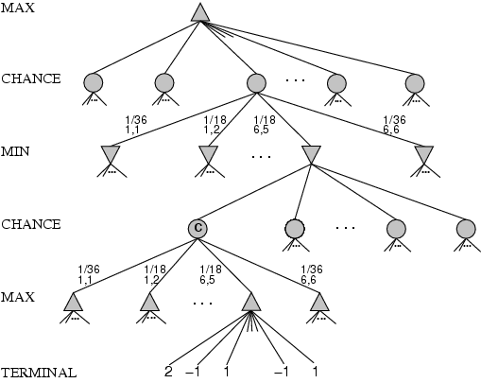
Games Involving Chance
chance nodes
Dice rolls: [1,1], …, [6,6] occur 1/36, all others occur 1/18
Can not calculate definite minimax value, only expected value

Slide 62
Expected Minimax
EXPECTIMINIMAX(s)=
UTILITY(s) If TERMINAL-TEST(s)
max_{a} EXPECTIMINIMAX(RESULT(s, a)) If PLAYER(s)=MAX
min_{a} EXPECTIMINIMAX(RESULT(s, a)) If PLAYER(s)=MIN
∑_{r} P(r)*EXPECTIMINIMAX(RESULT(s, r)) If PLAYER(s)=CHANCE
These equations can be backed-up recursively to the root of the game tree, just as with regular minimax
Time complexity is O(b^{m}n^{m}), where n is number of distinct rolls
Analogues of alpha-beta exist
Notes:
R is a random choice

Slide 63
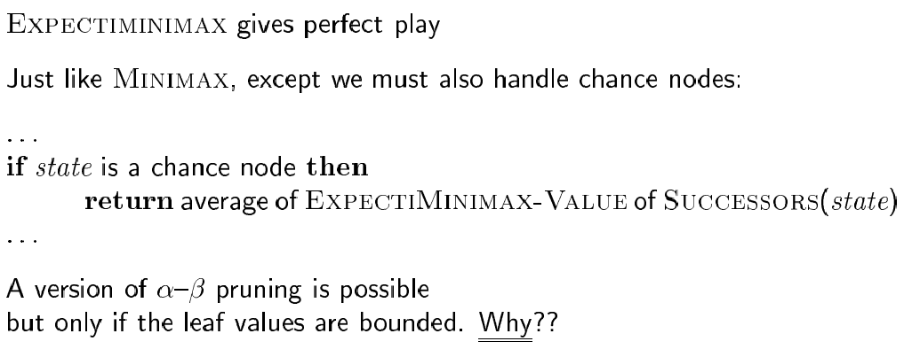
Algorithm for nondeterministic games

Slide 64
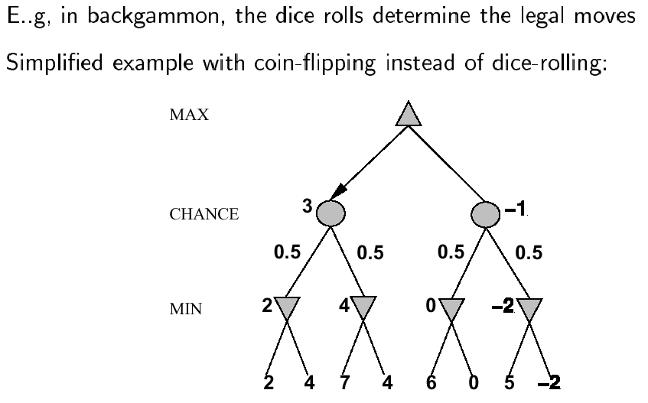
Nondeterministic games

Slide 65
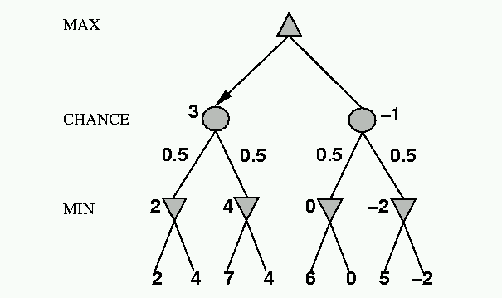
Nondeterministic games: the element of chance
expectimax and expectimin, expected values over all possible outcomes
CHANCE
?
0.5
0.5
3
?
?
8
17
8

Slide 66
Nondeterministic games: the element of chance
4 = 0.5*3 + 0.5*5
Expectimax
CHANCE
0.5
0.5
5
3
5
Expectimin
8
17
8

Slide 67
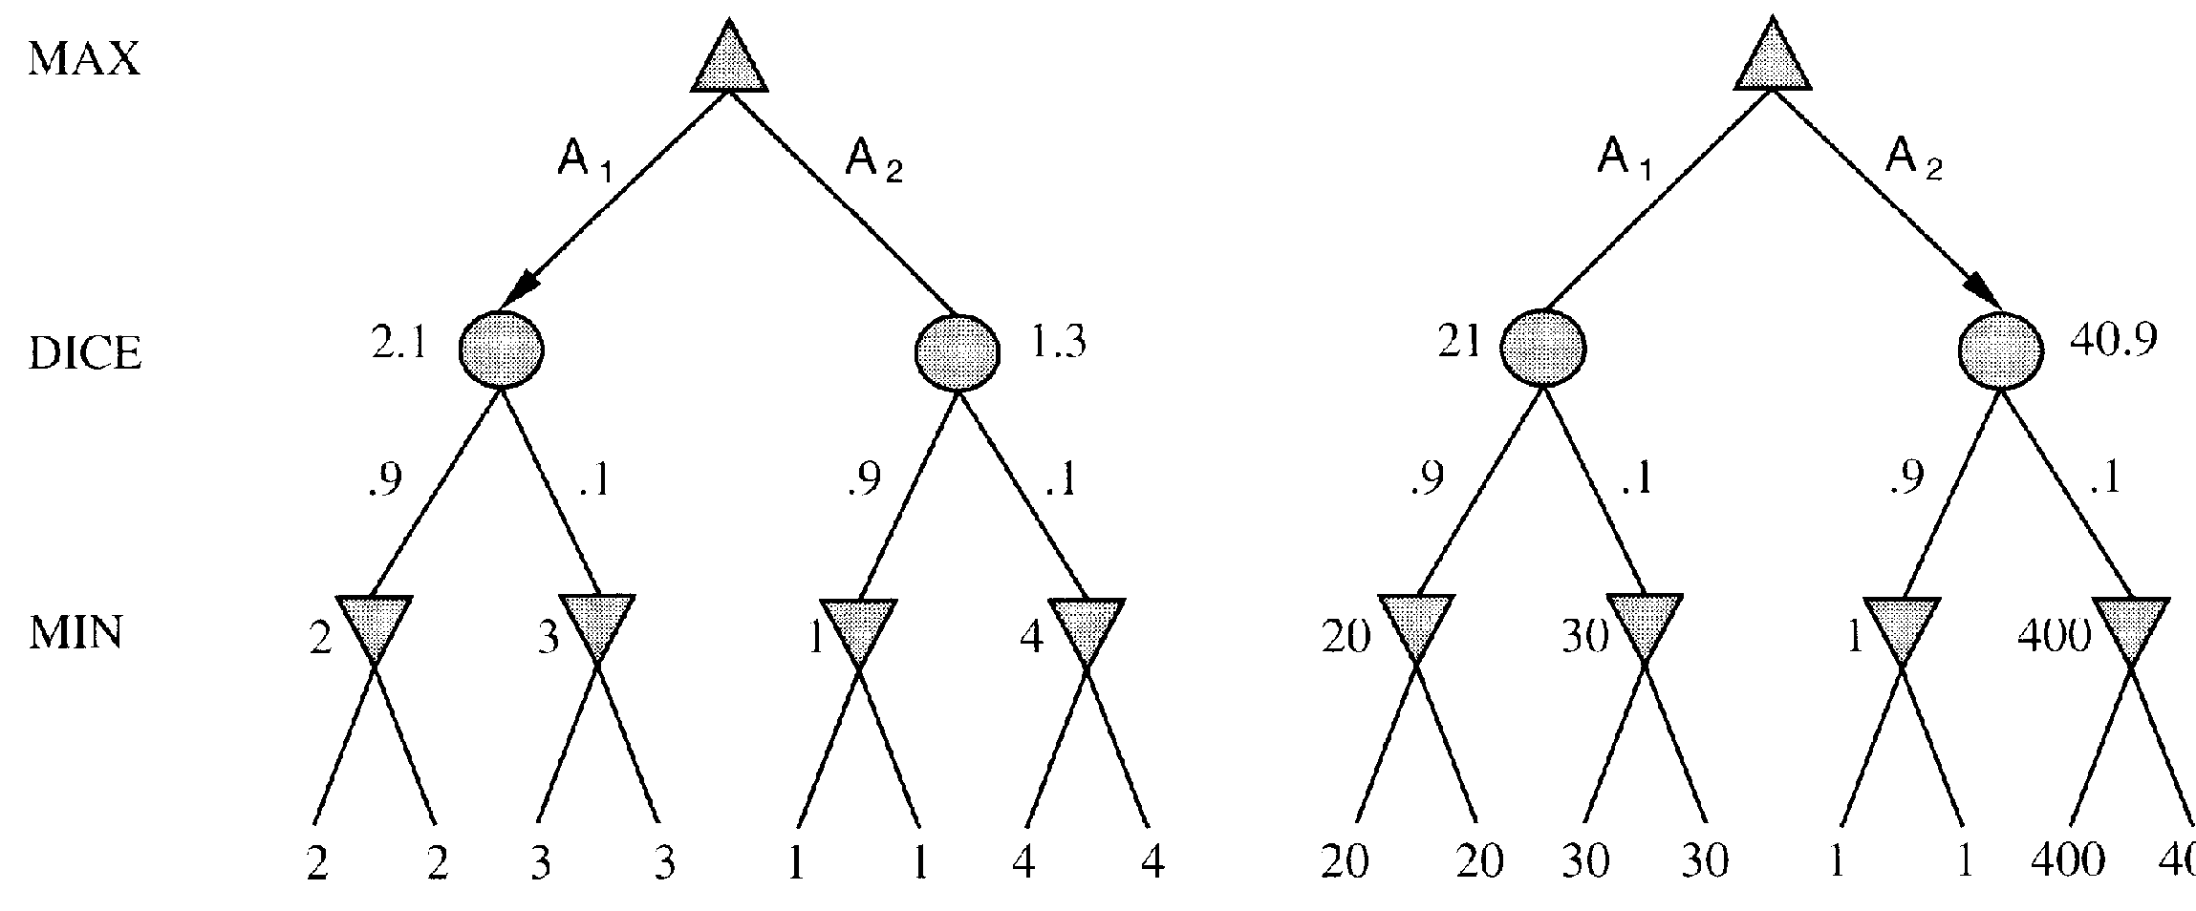
Evaluation functions: Exact values DO matter
Order-preserving transformation do not necessarily behave the same!
400

Slide 68
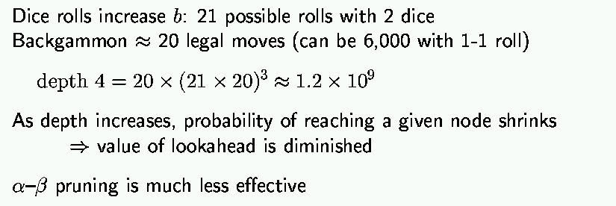
Isssues for nondeterministic games

Slide 69
State-of-the-art
Poker
Plays competitively with top human players
“Solved” for heads-up limit Texas hold ‘em
Not guaranteed to win each game, but comes out ahead over enough hands
Learned a database of values through self-play
No-limit Texas hold ‘em – “Libratus” by CMU
Beat top human players in the tournament (2017)
Jan 11-30, 2017 @ Rivers Casino, Pittsburgh Tuomas Sandholm Noam Brown

Slide 70
Summary
Games are fun to work on!
Illustrate key points about AI:
Perfection not possible => Must approximate!
Important to have multiple ways of doing something e.g. To answer “what move to make?” can use:
Search
Evaluation function
Must operate in an uncertain world
For next week: Chapter 6: Constraint Satisfaction Problems and Chapter 7: Propositional Logic

